Slide 1
TELECOM CHURN PREDICTION

Slide 2
Contents
Overview of the project
Data science lifecycle
Understanding the data set.
Gantt Chart

Slide 3
Overview of the Project.
What is churn?
The number of existing customers who may leave the service provider over a given period.
The main aim of our project is to predicting customer churn using machine learning models.

Slide 4
About our Project
Our project is targeting the number of customers who are leaving telecom industry.
Our project has dataset consisting of approximately 7000+ customers.

Slide 5
1. Business Problem Understanding
3. Data Cleaning and Preparation
4. Exploratory Data Analysis
5. Feature Learning
6. Predictive Modeling
2. Data Collection
7. Data Visualization
DATA SCIENCE
LIFE CYCLE

Slide 6
Understanding the dataset
There are 7043 rows and 21 Features (Target Variable - Churn)
1. customerID
2. gender - Whether the customer is a male or a female
3. SeniorCitizen - Whether the customer is a senior citizen or not (1, 0)
4. Partner - Whether the customer has a partner or not (Yes, No)
5. Dependents - Whether the customer has dependents or not (Yes, No)
6. tenure -Number of months the customer has stayed with the company
7. PhoneService - Whether the customer has a phone service or not (Yes, No)
8. MultipleLines - Whether the customer has multiple lines or not (Yes, No, No phone service)
9. InternetService - Customer’s internet service provider (DSL, Fiber optic, No)
10. OnlineSecurity - Whether the customer has online security or not (Yes, No, No internet service)

Slide 7
11. OnlineBackup - Whether the customer has online backup or not (Yes, No, No internet service)
12. DeviceProtection - Whether the customer has device protection or not (Yes, No, No internet service)
13. TechSupport - Whether the customer has tech support or not (Yes, No, No internet service)
14. StreamingTV - Whether the customer has streaming TV or not (Yes, No, No internet service)
15. StreamingMovies - Whether the customer has streaming movies or not (Yes, No, No internet service)
16. Contract - The contract term of the customer (Month-to-month, One year, Two year)
17. PaperlessBilling - Whether the customer has paperless billing or not (Yes, No)
18. PaymentMethod - The customer’s payment method (Electronic check, Mailed check, Bank transfer (automatic), Credit card (automatic)
19. MonthlyCharges - The amount charged to the customer monthly
20. TotalCharges - The total amount charged to the customer
21. Churn - Whether the customer churned or not (Yes or No)

Slide 8
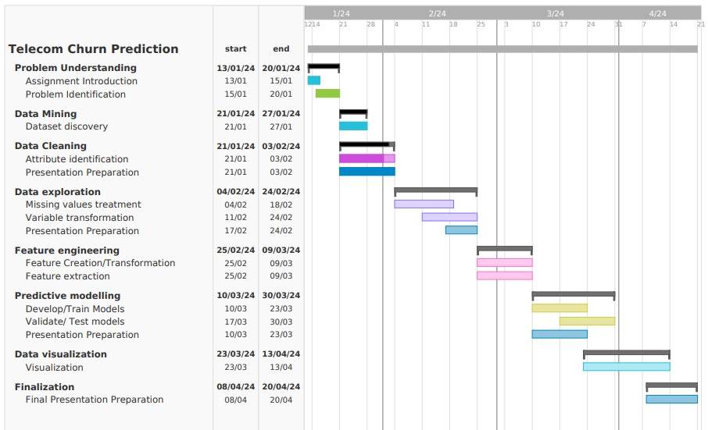
GANTT CHART

Slide 9
ANY QUESTIONS?

